Slide 1
Sarcasm Detection
with Attention added Deep-CNN
by Dong Hwan Kim - Team #25

Slide 2

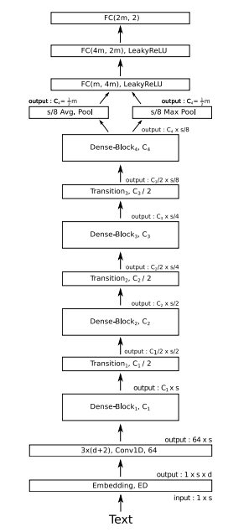
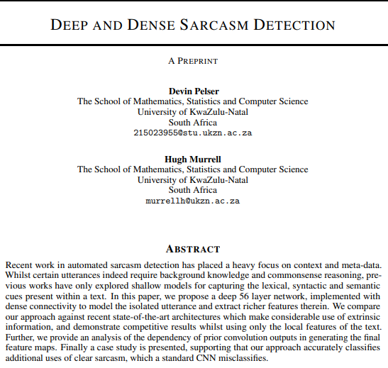
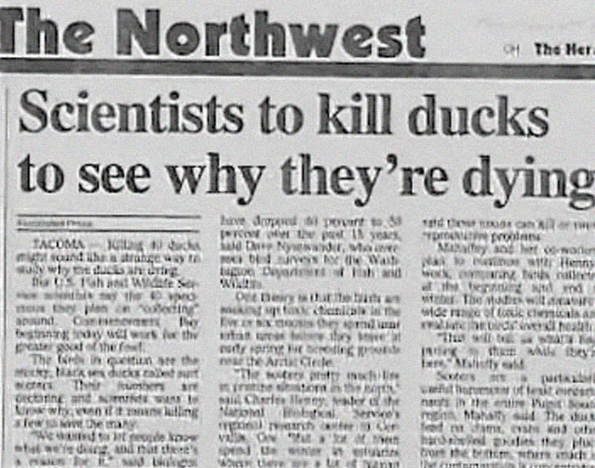

Slide 3
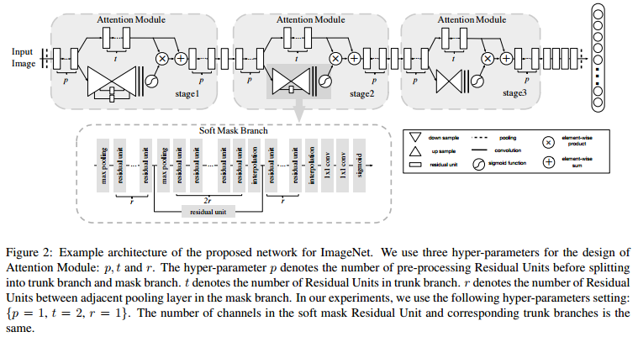
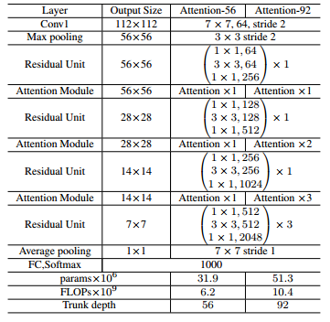
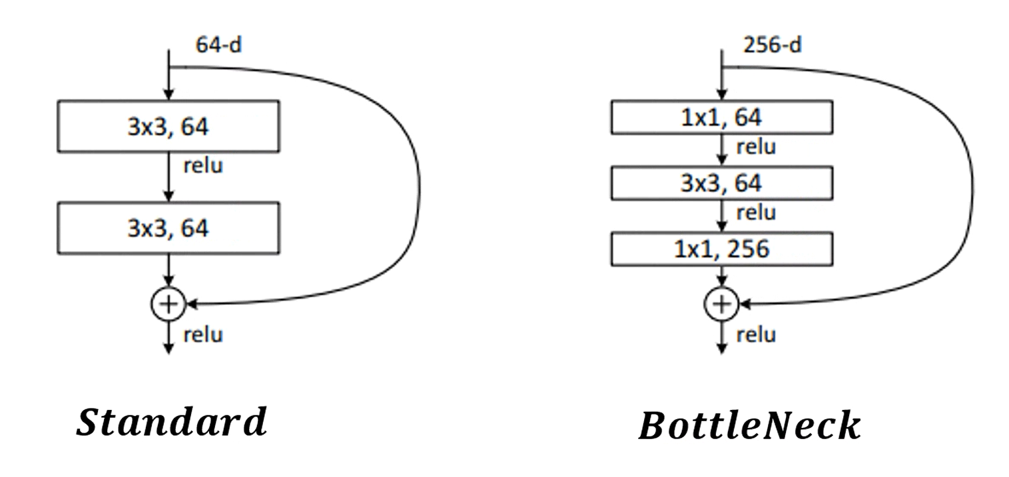
References. Pelser, D., & Murrell, H. (2019). Deep and Dense Sarcasm Detection. arXiv preprint arXiv:1911.07474.
Wang, F., Jiang, M., Qian, C., Yang, S., Li, C., Zhang, H., ... & Tang, X. (2017). Residual attention network for image classification. In Proceedings of the IEEE conference on computer vision and pattern recognition (pp. 3156-3164).

Slide 4
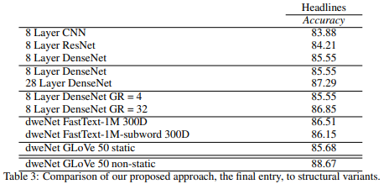
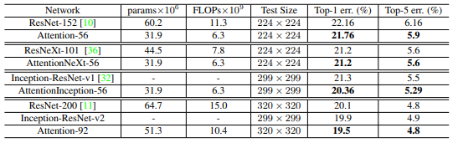
References. Pelser, D., & Murrell, H. (2019). Deep and Dense Sarcasm Detection. arXiv preprint arXiv:1911.07474.
Wang, F., Jiang, M., Qian, C., Yang, S., Li, C., Zhang, H., ... & Tang, X. (2017). Residual attention network for image classification. In Proceedings of the IEEE conference on computer vision and pattern recognition (pp. 3156-3164).

Slide 5
Thank You!

